Slide 1
Data Engineering
Submitted By
Maimoona Khilji

Slide 2
Content
What is:
Data Engineering basics?
Data Engineering end-to-end architecture?
Role of a Data Engineer?
What is Data Warehouse?
What is difference between Database and DWH

Slide 3
Data Engineering
A typical Data Engineering lifecycle includes architecting data platforms and designing data stores.
Data engineering refers to the building of systems to enable the collection and usage of data. This data is usually used to enable subsequent analysis and data science; which often involves machine learning.
It prepares the raw data so that it can be used further by data analysts and scientists to process it and draw helpful insights.

Slide 4
Data Engineering
Data engineering is the complex task of making raw data usable to data scientists and groups within an organization.
It also includes the process of
Gathering
Importing
Wrangling
Cleaning
Querying
Analyzing data
Systems and workflows need to be monitored and fine-tuned for performance at optimal levels.

Slide 5
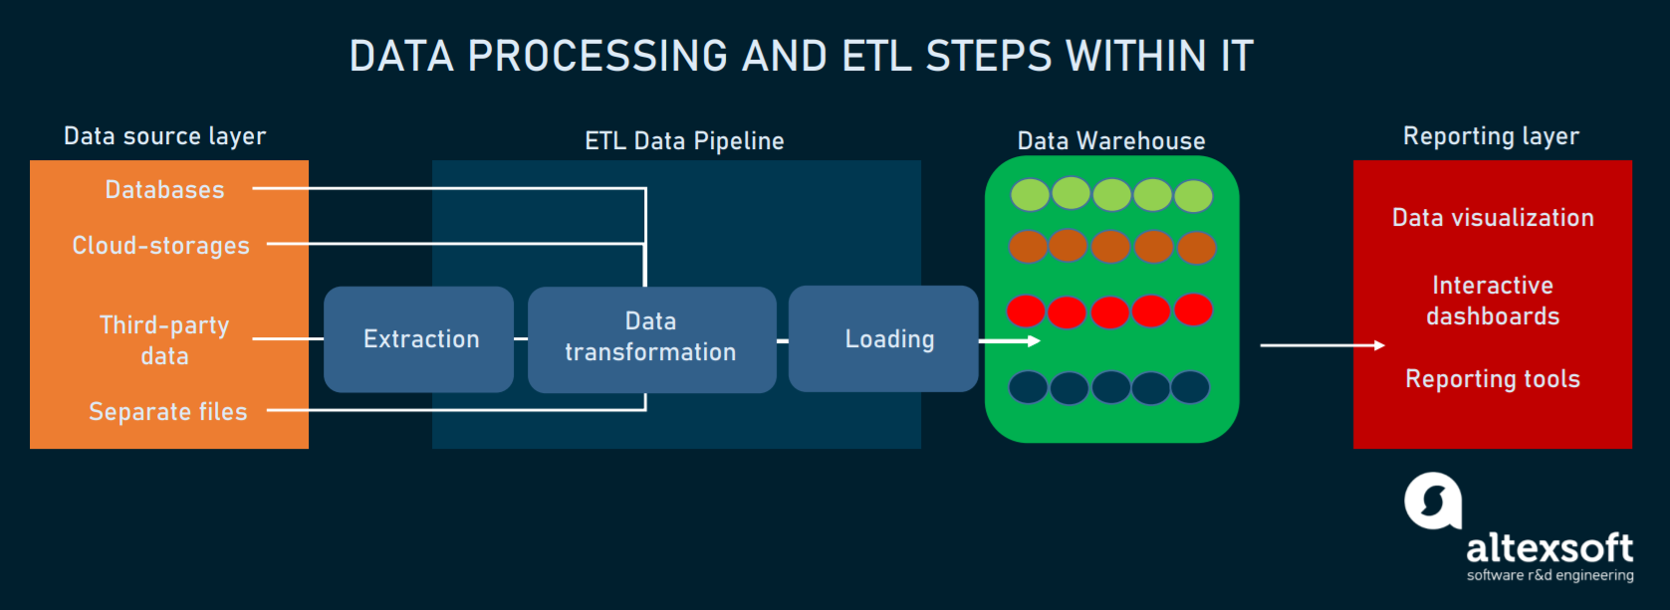
Data Engineering end-to-end architecture

Slide 6
Role of a Data Engineer
Data engineers work in a variety of settings to build systems that collect, manage, and convert raw data into usable information for data scientists and business analysts to interpret. Their ultimate goal is to make data accessible so that organizations can use it to evaluate and optimize their performance.
Here is the list of roles and responsibilities, Data Engineers are expected to perform:
Work on Data Architecture:
They use a systematic approach to plan, create, and maintain data architectures while also keeping it aligned with business requirements.

Slide 7
Role of a Data Engineer
Collect Data:
Before initiating any work on the database, they have to obtain data from the right sources. After formulating a set of dataset processes, data engineers store optimized data.
Conduct Research
Data engineers conduct research in the industry to address any issues that can arise while tackling a business problem.
Improve Skills:
Data engineers don’t rely on theoretical database concepts alone. They must have the knowledge and power to work in any development environment. They must keep themselves up-to-date with machine learning and its algorithms. They are proficient in analytics tools. They use these tools to generate valuable business insights for all types of industries.
Notes:
Improve Skills
Machine learning algorithms: random forest, decision tree, k-means, and others.
Analytics tools like Tableau, Knime, and Apache Spark.
For instance, data engineers can make a difference in the health industry and identify patterns in patient behavior to improve diagnosis and treatment. Similarly, law enforcement engineers can observe changes in crime rates.

Slide 8
Role of a Data Engineer
Create Models and Identify Patterns:
Data engineers use a descriptive data model for data aggregation to extract historical insights. They also make predictive models where they apply forecasting techniques to learn about the future with actionable insights. Likewise, they utilize a prescriptive model, allowing users to take advantage of recommendations for different outcomes. A considerable chunk of a data engineer’s time is spent on identifying hidden patterns from stored data.
Automate Tasks:
Data engineers dive into data and pinpoint tasks where manual participation can be eliminated with automation.

Slide 9
Data Warehouse
A data warehouse is a central repository of information that can be analyzed to make more informed decisions.
Data flows into a data warehouse from transactional systems, relational databases, and other sources, typically on a regular cadence.
Business Intelligence helps to improve the business. It converts data into useful information for business analyzing. It also helps to make business insights for end users. Data warehouse supports business intelligence process. A company can have various databases by Oracle, MySQL, etc. It is not possible to directly visualize the data in these databases. A data warehouse provides a solution for this issue. It takes data, performs integration and data processing. This data can be used for visualization. Data warehouses are subject oriented, integrated, time variant and nonvolatile.

Slide 10
Difference between Database and DWH
Database | Data Warehouse
Definition
Database is an organized collection of related data which stores data in a tabular format. | A data warehouse, in contrast, is a central location which stores consolidated data from multiple databases.
Data Type
Database contains detailed data. | Data warehouse contains summarized data.
Processing Method
Database uses Online Transactional Processing (OLTP) | Data warehouse uses Online Analytical Processing (OLAP).

Slide 11
Difference between Database and DWH Cont.
Database | Data Warehouse
Usage
Database helps to perform fundamental operations of a business. | Data warehouse helps to analyze the business.
Speed and Accuracy
Database is slower than data warehouse | Data warehouse is faster and accurate than the normal database.
Orientation
Database is application oriented. | Data warehouse is subject oriented. It categorizes and stores by business subject rather than by application.

Slide 12
Difference between Database and DWH Cont.
Database | Data Warehouse
Tables and Joins
Tables and joins of a database are complex because they are normalized. This minimizes data redundancy. | Table and joins are simple in data warehouse because they are de- normalized. That is to reduce the response time for analytical queries.
Design Method
Entity relationship modelling helps to design a database. | Data modeling techniques help to design a data warehouse.
Conclusion
The difference between database and data warehouse is that database is an organized collection of related data which stores the data in a tabular format while a data warehouse is a central location which stores consolidated data from multiple databases. In brief, database helps to perform fundamental operations of a business while data warehouse helps to analyze the business.

Slide 13
References
https://www.altexsoft.com/blog/datascience/what-is-data-engineering-explaining-data-pipeline-data-warehouse-and-data-engineer-role/
https://www.simplilearn.com/data-engineer-role-article
https://pediaa.com/difference-between-database-and-data-warehouse/

Slide 14
THE END

